Slide 1
组 会 报 告
蓝 鑫
2019年4月23日

Slide 2
目录
文献
实验

Slide 3
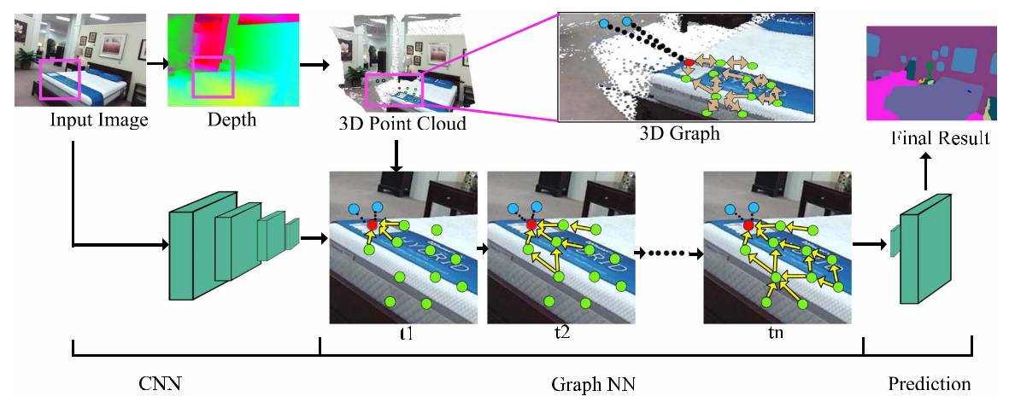
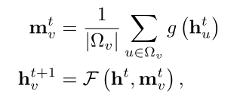
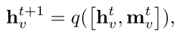
3D Graph
Qi, X., Liao, R., Jia, J., Fidler, S., & Urtasun, R. (2017, 22-29 Oct. 2017). 3D Graph Neural Networks for RGBD Semantic Segmentation. Paper presented at the ICCV 2017.
利用深度图生成 3D 点云。
在 3D 点云中获取 k 个近邻索引。
将近邻向量送入 MLP，迭代 T 个时间步。
图网络输出和 CNN 编码的特征级联，送入解码器。

Slide 4
A | car | bike | person | sky | tree | grass | road | sidewalk | building | fence | sign | pole | block | mIoU
VS | 56.30 | 49.17 | 35.14 | 54.48 | 74.12 | 38.46 | 93.41 | 40.04 | 53.89 | 50.93 | 14.74 | 4.45 | 1.39 | 43.58
IR | 60.20 | 8.35 | 48.16 | 76.50 | 77.49 | 37.26 | 94.25 | 41.69 | 61.08 | 51.71 | 1.91 | 0.11 | 2.71 | 43.19
FS | 64.62 | 45.25 | 41.01 | 77.58 | 80.86 | 48.78 | 94.15 | 41.08 | 65.34 | 56.85 | 4.21 | 6.44 | 0.16 | 48.18
B | car | bike | person | sky | tree | traffic light | road | sidewalk | building | fence | sign | pole | bus | mIoU
VS | 67.13 | 10.39 | 20.61 | 64.93 | 72.49 | 3.28 | 88.06 | 10.83 | 49.65 | 22.64 | 16.50 | 8.85 | 37.63 | 36.43
IR | 44.08 | 9.96 | 37.55 | 76.35 | 72.88 | 0.64 | 85.24 | 21.16 | 56.78 | 8.82 | 0.07 | 1.55 | 26.27 | 33.95
FS | 62.16 | 20.05 | 30.83 | 75.82 | 75.12 | 2.24 | 87.81 | 18.07 | 60.97 | 27.53 | 13.29 | 8.64 | 33.01 | 39.66

Slide 5
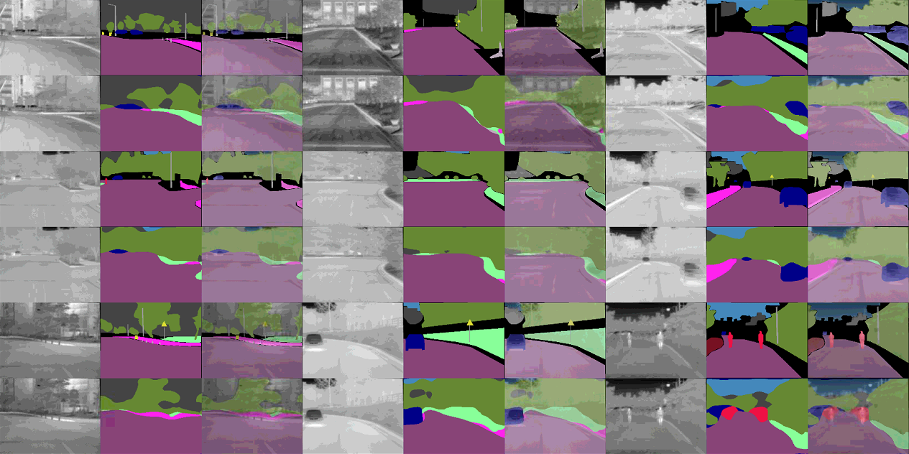
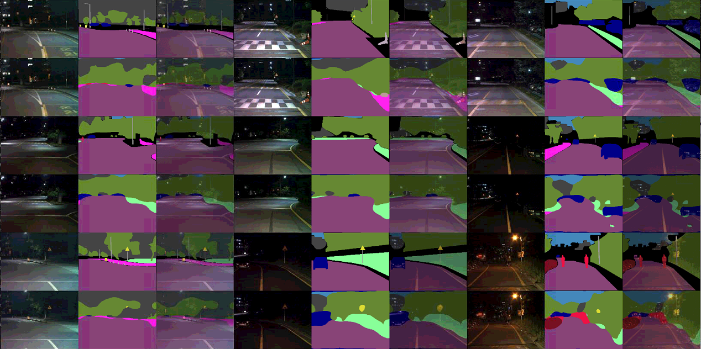
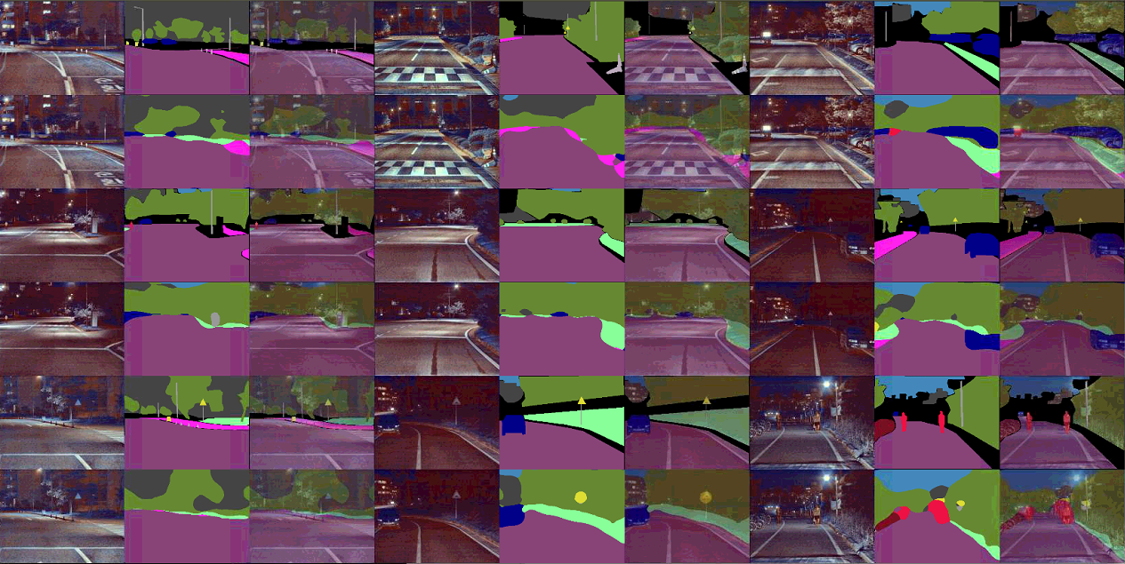

Slide 6
